Slide 1
Databases, DBMS and SQL
IICT Lecture 04

Slide 2
Role of Data in Computer
Data
A collection of facts (numbers, words, measurements, observations, etc) that has been translated into a form that computers can process
Introduction to Database Systems

Slide 3
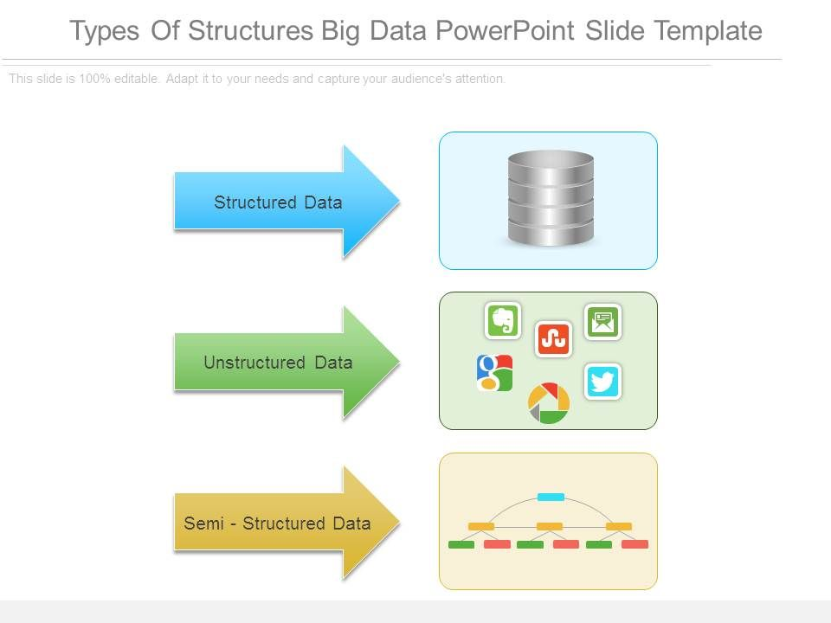
Types of Data
Structured data
  Information stored in DB
  Strict format
Semi-structured data
  Data may have certain structure but not all information collected has identical structure
  Some attributes may exist in some of the entities of a particular type but not in others
Unstructured data
  Very limited indication of data type
    E.g., a simple text document
Introduction to Database Systems
Notes:
For example, data from social media or websites can be used to figure out future buying trends or to determine the effectiveness of a marketing campaign. Moreover, unstructured data helps in detecting patterns in scam emails and chat, which can be useful for enterprises for monitoring policy compliance.
Semi-structured data is not properly structured into cells or columns. However, it does have elements that makes it easy to separate fields and records. These can be comma or colons or anything else for that matter. An example of a semi-structured data is a JSON query.

Slide 4
Why Study Databases?
Databases are useful
  Many computing applications deal with large amounts of information
  Database systems give a set of tools for storing, searching and managing this information
Databases in CS
  Databases are a ‘core topic’ in computer science
  Basic concepts and skills with database systems are part of the skill set you will be assumed to have as a CS graduate

Slide 5
What is a Database?
An organized collection of Data
A comprehensive collection of related data organized for convenient access, generally in a computer

Slide 6
What is a Database?
“A set of information held in a computer”
      Oxford English Dictionary
“One or more large structured sets of persistent data, usually associated with software to update and query the data”
      Free On-Line Dictionary of Computing
“A collection of data arranged for ease and speed of search and retrieval”
      Dictionary.com

Slide 7
Databases
Library catalogues
Medical records
Bank accounts
Stock control
Product catalogues
Telephone directories
Train timetables
Airline bookings
Credit card details
Student records
Customer histories
and so on…

Slide 8
Database Systems
A database system consists of
  Data (the database)
  Software
  Hardware
  Users
We focus mainly on the software
Database systems allow users to
  Store
  Update
  Retrieve
  Organise
  Protect
their data.

Slide 9
Database Management Systems
A database is a collection of information
A database management system (DBMS) is the software than controls that information
Examples:
  Oracle
  DB2 (IBM)
  MS SQL Server
  MS Access
  Ingres
  PostgreSQL
  MySQL

Slide 10
What the DBMS does
Provides users with
  Data definition language (DDL)
  Data manipulation language (DML)
  Data control language (DCL)
Often these are all the same language
DBMS provides
  Persistence
  Concurrency
  Integrity
  Security
  Data independence
Data Dictionary
  Describes the database itself
Notes:
In other words, for a data store to be considered persistent, it must write to non-volatile storage.
Data concurrency means that many users can access data at the same time. Data consistency means that each user sees a consistent view of the data, including visible changes made by the user's own transactions and transactions of other users.
Data integrity is the overall completeness, accuracy and consistency of data. This can be indicated by the absence of alteration between two instances or between two updates of a data record, meaning data is intact and unchanged.

Slide 11
Types of SQL Statements
DDL stands for Data Definition Languages (DDL). The SQL statements that are used to define the database structure. Any CREATE, DROP and ALTER commands are examples of DDL SQL.
DML stands for Data Manipulation Language. The SQL statements that are in the DML class are INSERT, UPDATE and DELETE.
DCL stands for Data Control Language, it includes commands such as GRANT and REVOKE which mainly deals with the rights, permissions and other controls of the database system.

Slide 12
Data Dictionary - Metadata
The dictionary or catalog stores information about the database itself
This is data about data or ‘metadata’
Almost every aspect of the DBMS uses the dictionary
The dictionary holds
  Descriptions of database objects (tables, users, rules, views, indexes,…)
  Information about who is using which data (locks)

Slide 13
File Based Systems
File based systems
  Data is stored in files
  Each file has a specific format
  Programs that use these files depend on knowledge about that format
Problems:
  No standards
  Data duplication
  Data dependence
  No provision for security, recovery.

Slide 14
Relational Systems
Information is stored as tuples or records in relations or tables
There is a sound mathematical theory of relations
Most modern DBMS are based on the relational model

Slide 15
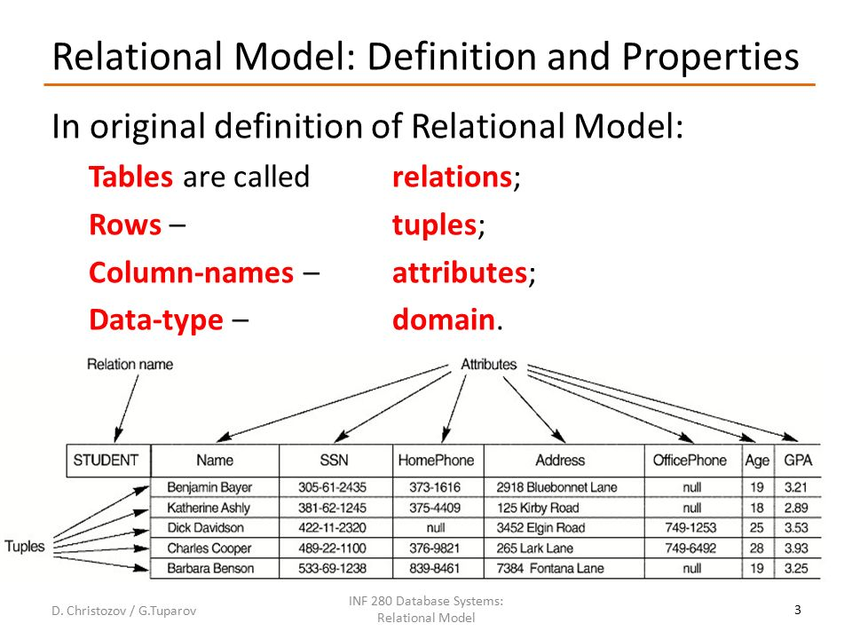
Relational Systems

Slide 16
Database Model
Database model defines the logical design of data.
Database model describes the relation between different parts of data.
There are three database models:
    Hierarchical Model
    Network Model
    Relational Model

Slide 17
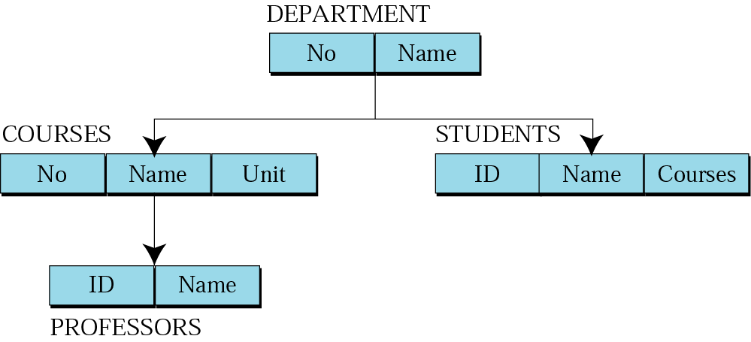
Hierarchical model
Data are organized in an upside down tree
Each entity has one parent and many children
Old and not used now

Slide 18
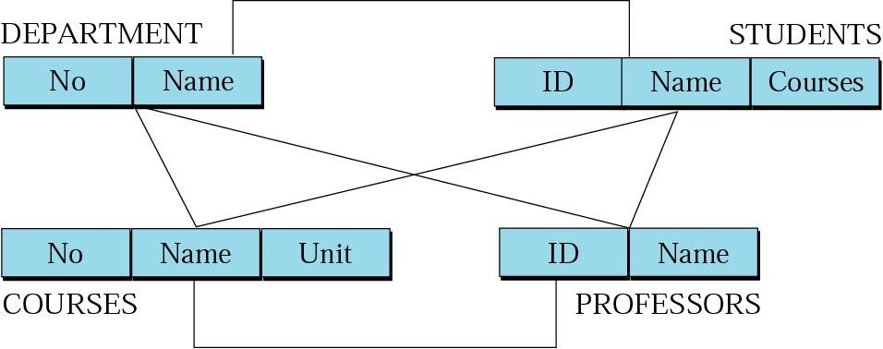
Network model
Entities are organized in a graph
Entities can be accessed through several paths
Old and not used

Slide 19
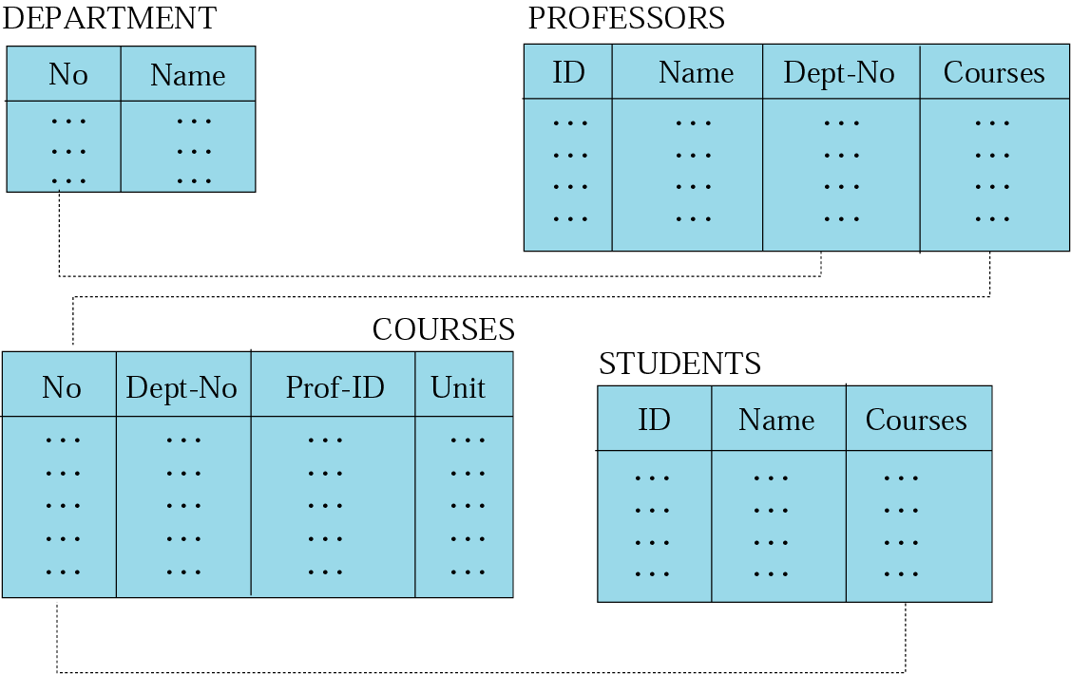
Relational model
Data are organized in two dimensional tables (relations)
Tables re related to each other
Relational Database Management System (RDBMS) are more common model used today

Slide 20
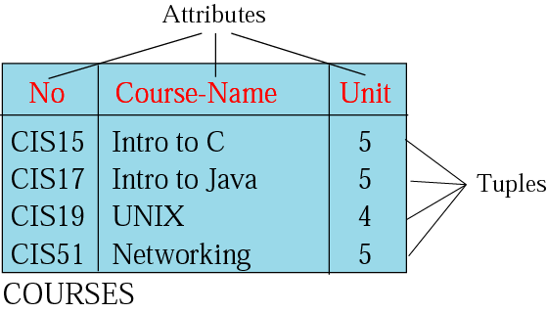
Relation (Name, Attributes, Tuples)
Attributes are the column heading
Each column must have a unique heading
Number of columns is called the degree of the relation
Tuple is a collection of attribute value
Total number of rows is called Cardinality of the relation
Each relation must have a unique name
Name
Relation appears in 2 dimensional table
That doesn’t mean data stored as table; the physical storage of data is independent of the logical organization of data
Notes:
A single row of a table, which contains a single record for that relation is called a tuple.
Relation instance − A finite set of tuples in the relational database system represents relation instance.

Slide 21
OPERATIONS
ON
RELATIONS

Slide 22
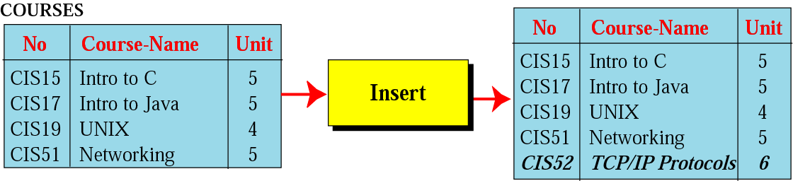
Insert operation
Unary operation
Insert Operation: Inserts new tuple into the relation

Slide 23
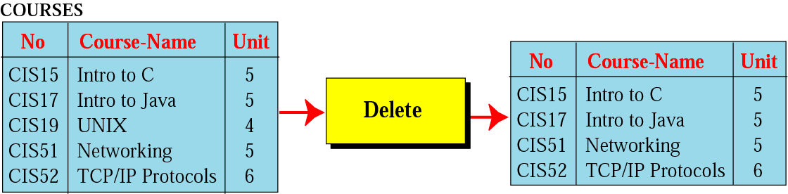
Delete operation
Unary operation
Delete Operation: Deletes tuple from the relation

Slide 24
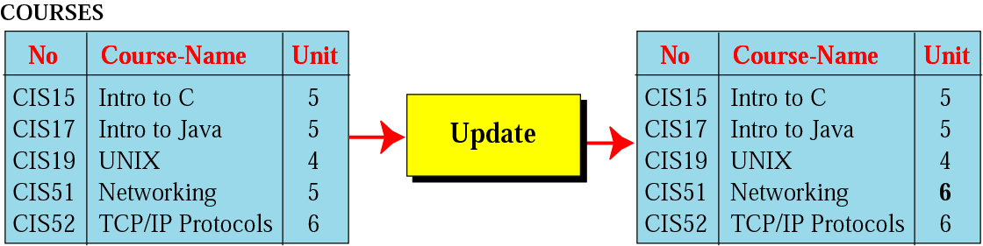
Update operation
Unary operation
Update Operation: Changes the values of some attributes of a tuple

Slide 25
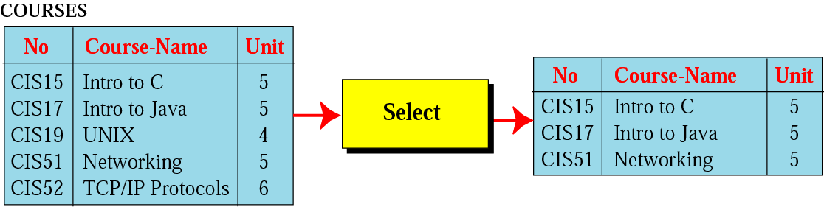
Select operation
Unary operation
Select Operation: Uses some criteria to select some tuples from the original relation

Slide 26
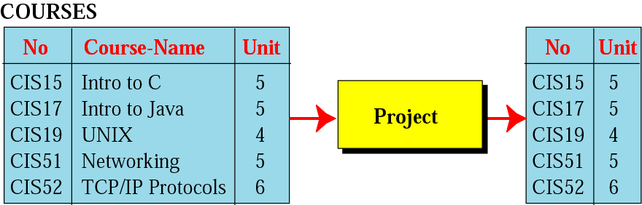
Project operation
Unary operation
Project Operation: Creates relation in which each tuple has fewer attributes

Slide 27
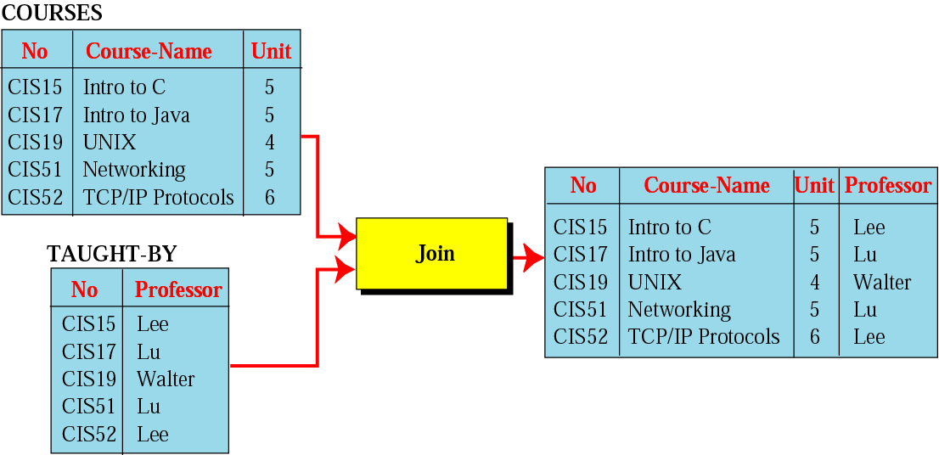
Join operation
Binary operation
Join Operation: Takes two relation and combine them based on common attribute

Slide 28
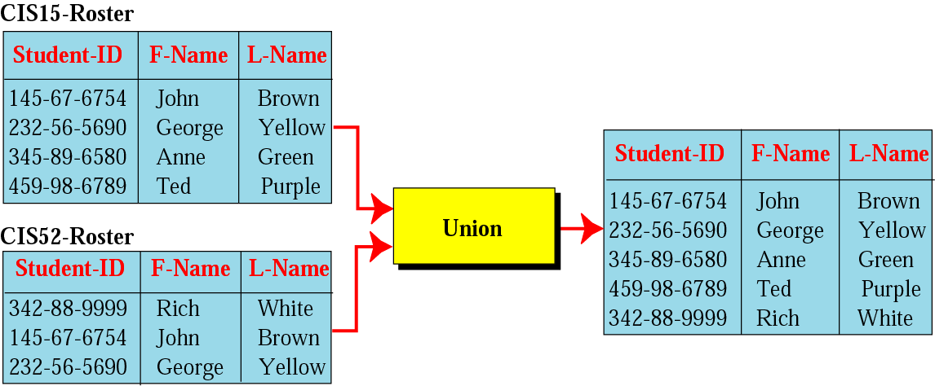
Union operation
Binary operation
Union Operation: Creates new relation in which each tuple is either in the first relation, the second relation or in both

Slide 29
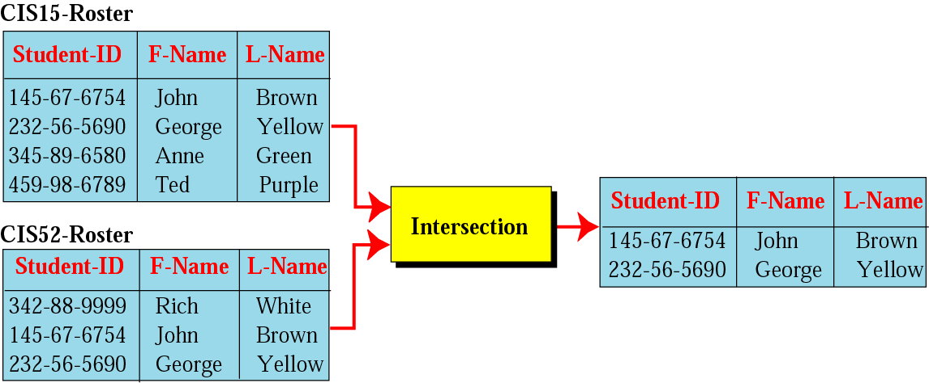
Intersection operation
Binary operation
Intersection Operation: Creates new relation in which each tuple is in both relations.

Slide 30
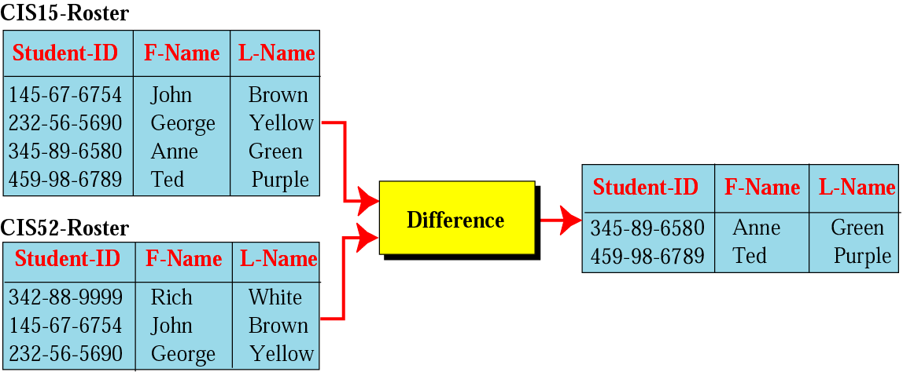
Difference operation
Binary Operation
Difference Operation: Creates new relation where the new tuples are in the first relation but not in the second.

Slide 31
Database Management System
A database management system (DBMS) is system software for creating and managing Database.
The DBMS provides users and programmers with a systematic way to create, retrieve, update and manage data.
DBMS allow all the operations on database discussed in previous slides
  Insert, Delete, retrieve, Union, Join etc…

Slide 32
STRUCTURED
QUERY
LANGUAGE

Slide 33
SQL
SQL is the standard language used for relational databases.
It is declarative language where users declare what they want without having to write a step by step procedure.
It was first implemented by Oracle Corporation

Slide 34
1. Insert
SQL Insert Operation format
insert into RELATION-NAME
values (…, …, …)

Slide 35
Insert (Example)
insert into COURSES
values (“CIS52”, “TCP/IP Protocols”, 6)

Slide 36
2. Delete
SQL Delete Operation format
delete from RELATION-NAME
where criteria

Slide 37
Delete (Example)
Delete from COURSES
where No = “CIS19”

Slide 38
3. Update
SQL Update Operation format
update RELATION-NAME
set attribute1 = value1 attribute 2 = value2 …
where criteria

Slide 39
Update (Example)
update COURSES
set unit = 6
where No = “CIS51”

Slide 40
4. Select
SQL Select Operation format
select *
from RELATION-NAME
where criteria

Slide 41
Select (Example)
select *
from COURSES
where Unit = 5

Slide 42
5. Project
SQL Project Operation format
select attribute-list
from RELATION-NAME

Slide 43
Project (Example)
select No, Unit
from COURSES

Slide 44
6. Join
SQL Join Operation format
select attribute-list
from RELATION NO1, RELATION NO2
where criteria

Slide 45
Join (Example)
select No, Course-Name, Unit, Professor
from COURSES, TAUGHT-BY
where COURSES.No = TAUGHT-BY.No;

Slide 46
7. Union
SQL Union Operation format
select *
from RELATION NO1
union
select *
from RELATION NO2

Slide 47
Union (Example)
select *
from CIS15-Roster
union
select *
from CIS52-Roster;

Slide 48
8. Intersection
SQL Intersection Operation format
select *
from RELATION NO1
intersection
select *
from RELATION NO2

Slide 49
Intersection (Example)
select *
from CIS15-Roster
intersection
select *
from CIS52-Roster;

Slide 50
9. Difference
SQL Difference Operation format
select *
from RELATION NO1
minus
select *
from RELATION NO2

Slide 51
Intersection (Example)
select *
from CIS15-Roster
minus
select *
from CIS52-Roster;

Slide 52
OTHER
DATABASE
MODELS

Slide 53
The levels of Data
Database | One or more tables
Table (relation) | A collection of Records
Record | A group of related fields
Field | One or more character
Character | At least 8 bits
Bit | 0 or 1

Slide 54
5 characteristics of Good Database
Data Integrity | Ensuring data is valid
Data Independence | Data is separated from software
Avoiding data Redundancy | Repetition of input data is avoided
Data Security | Data is not accessible to unauthorized users
Data Maintenance | Set procedures for adding ,deleting … records for the purpose of optimization

Slide 55
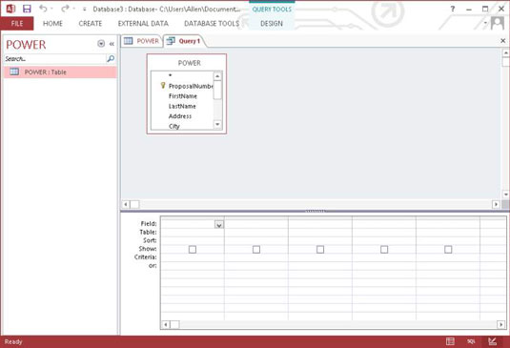
How To Write And Run SQL Query
Open your database and click the CREATE tab.
  This will display the ribbon across the top of the window.
Click Query Design in the Queries section.
  The Show Table dialog box appears.
Select the POWER table. Click the Add button and then click the Close button to close the dialog box.

Slide 56
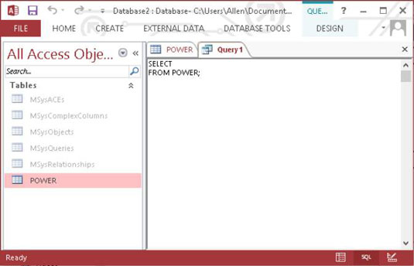
How To Write And Run SQL Query
Click the Home tab and then the View icon in the left corner of the Ribbon.
  A menu drops down, displaying the different views available to you in query mode. One of those views is SQL View.
Click SQL View to display the SQL View Object tab.

Slide 57
How To Write And Run SQL Query
Fill in an asterisk (*) in the blank area in the first line and add a WHERE clause after the FROM line.
  If you had already entered some data into the POWER table, you could make a retrieval with something like:
  SELECT * FROM POWER WHERE LastName = 'Marx' ;
Enter a name and then click OK.
  Your statement is saved and can be executed as a query later.

